Slide 1

LEARNING LAB, Part 2
Learning Lab, Part 2:
An interactive, guided session where students can follow along on a practical data science project. Learn how to explore, analyse and visualise data using Excel, Tableau and R.
Exploratory Data Analysis
Modelling
Data Visualisation & Communication

Slide 2
The Data Science Process
Asking Questions of the Data
Part 1
Collection
Learning Lab
Part 2
Exploration
Modelling
Communicate the Results

Slide 3
Exploratory Data Analysis
Exploratory Data Analysis (EDA) is the process of summarising data using summary statistics and data visualisation

Slide 4
Exploratory Data Analysis
Why do we need to explore the data?
1. To spot problems
> Missing values, bad fields or variables, identifying outliers
> Identify what needs formatting and cleansing

Slide 5
Exploratory Data Analysis
Why do we need to explore the data?
2. To give a sense of the data
> Build a more detailed picture of the data
> Explore summary statistics
> To refine our question (if necessary)

Slide 6

Exploratory Data Analysis
DEMO
Exploratory Data Analysis
Let’s explore our data on diabetes, identify some problems, undertake basic data cleaning and create some quick data visualisations.
Please feel free to follow along or explore for yourself. This demo will use Excel

Slide 7
Modelling
Modelling
Modelling is the stage where we extract valuable insights from the data

Slide 8
Modelling
Common Modelling Tasks:
Classification - Finding out if something belongs to one thing or another
Scoring - Predicting or estimating a numeric value, such as price
Ranking - Ordering items by preferences
Clustering - Grouping items into most-similar groups
Finding Relations - Identifying correlations or causes
Characterisation - Plotting and report-writing

Slide 9
Modelling
Modelling
> For each modelling task, there are multiple options to choose from
> Evaluating models is very important.
Example questions:
Is the model accurate enough, is it generalisable and how does it compare to other models?

Slide 10
Modelling
Please be mindful…
Correlation does not imply causation

Slide 11

Modelling
DEMO
Modelling
Let’s use predictive analytics to forecast demand for diabetes medication in Leeds. We’ll look at choosing the right model and finally visualise the results.
a different question to answer!
This demo is in R, a powerful open source statistical programming tool that can seem a bit daunting. Feel free to follow along with the process or explore the code for yourself. The code is publicly available.

Slide 12
Data Visualisation
and Communication
Data Visualisation
The ability to communicate information and the results of a data science project is hugely important.
Storytelling with data is a powerful way to communicate your message
But it should be grounded in some rules

Slide 13
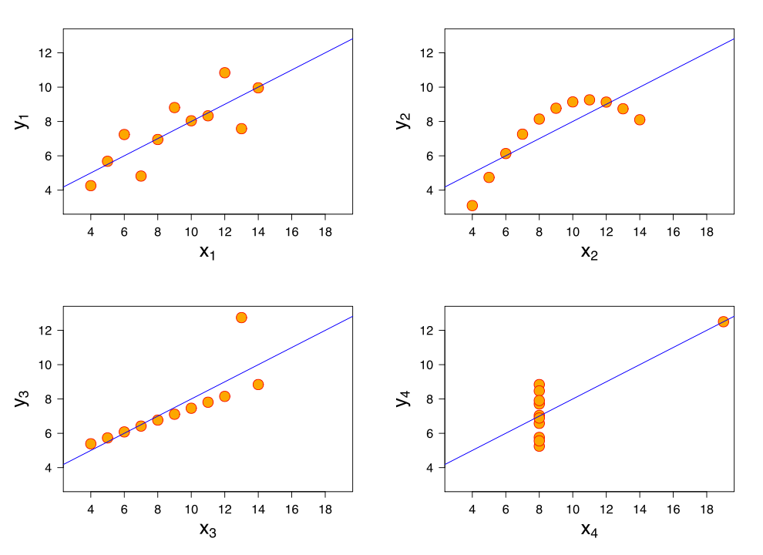
Data Visualisation
and Communication
These charts all have the same mean and standard deviation
Source: Alan Smith, FT

Slide 14
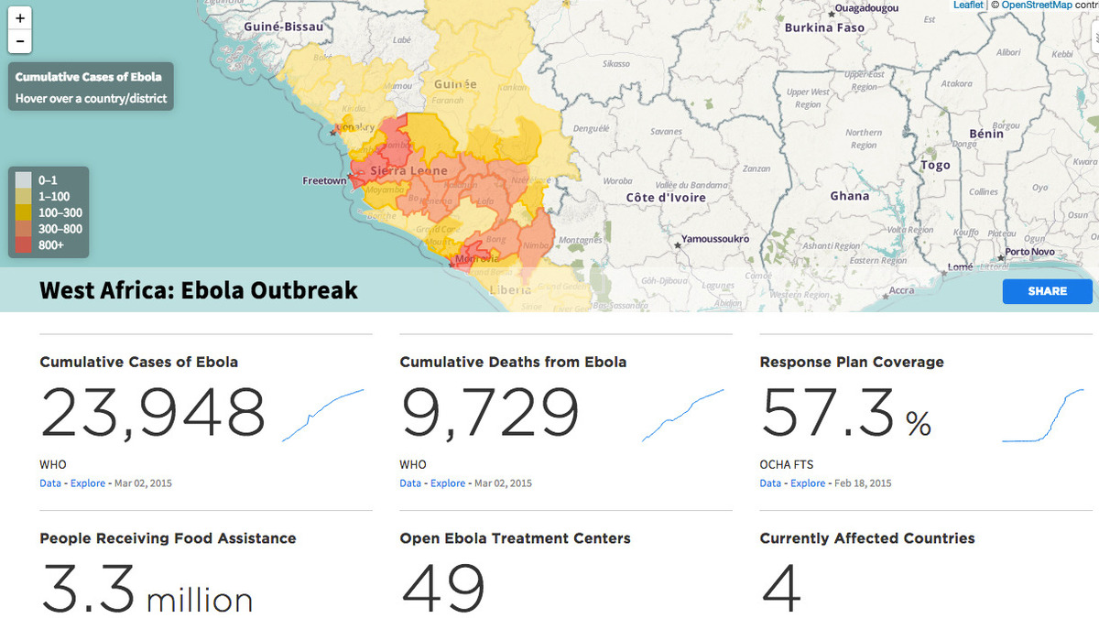
Data Visualisation
and Communication
Exploratory Data Visualisation
> The user is free to ask questions of the visualisation and explore and find insights
> Discovery a key element
> No single narrative
> Often interactive
Humanitarian Data Exchange (HDX) www.data.hdx.rwlabs.org/ebola

Slide 15
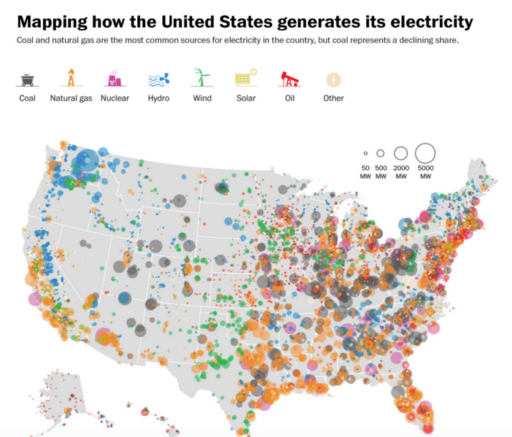
Data Visualisation
and Communication
Explanatory Data Visualisation
> Focused on one or more key insights
> Greater element of storytelling in their production
> Less discovery-led
> Data Journalism tends to be more explanatory, for example
Exploratory
Explanatory
Washington Post
https://www.washingtonpost.com/graphics/national/power-plants/

Slide 16
Data Visualisation
and Communication
Some Principles for Data Visualisation
> Choose the most appropriate and effective visualisations
> Always keep your audience in mind and
do not deceive them simply to make a point
> A little design goes a long way
> Be careful with your choice of colour
> Choose your chart types with care
> In the vast majority of cases, do not mess with axes
> Don’t use 3D graphics and avoid pie charts
> Take care with proportional graphics

Slide 17
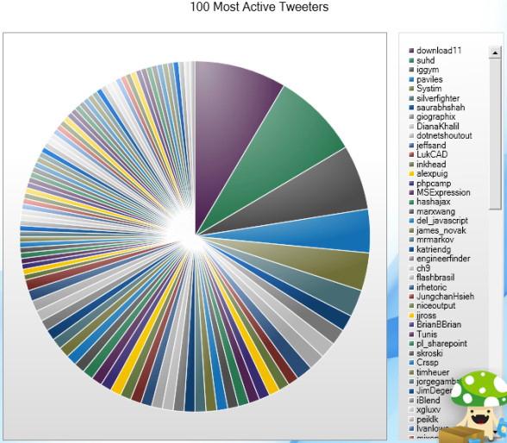
Data Visualisation
and Communication
NO!

Slide 18
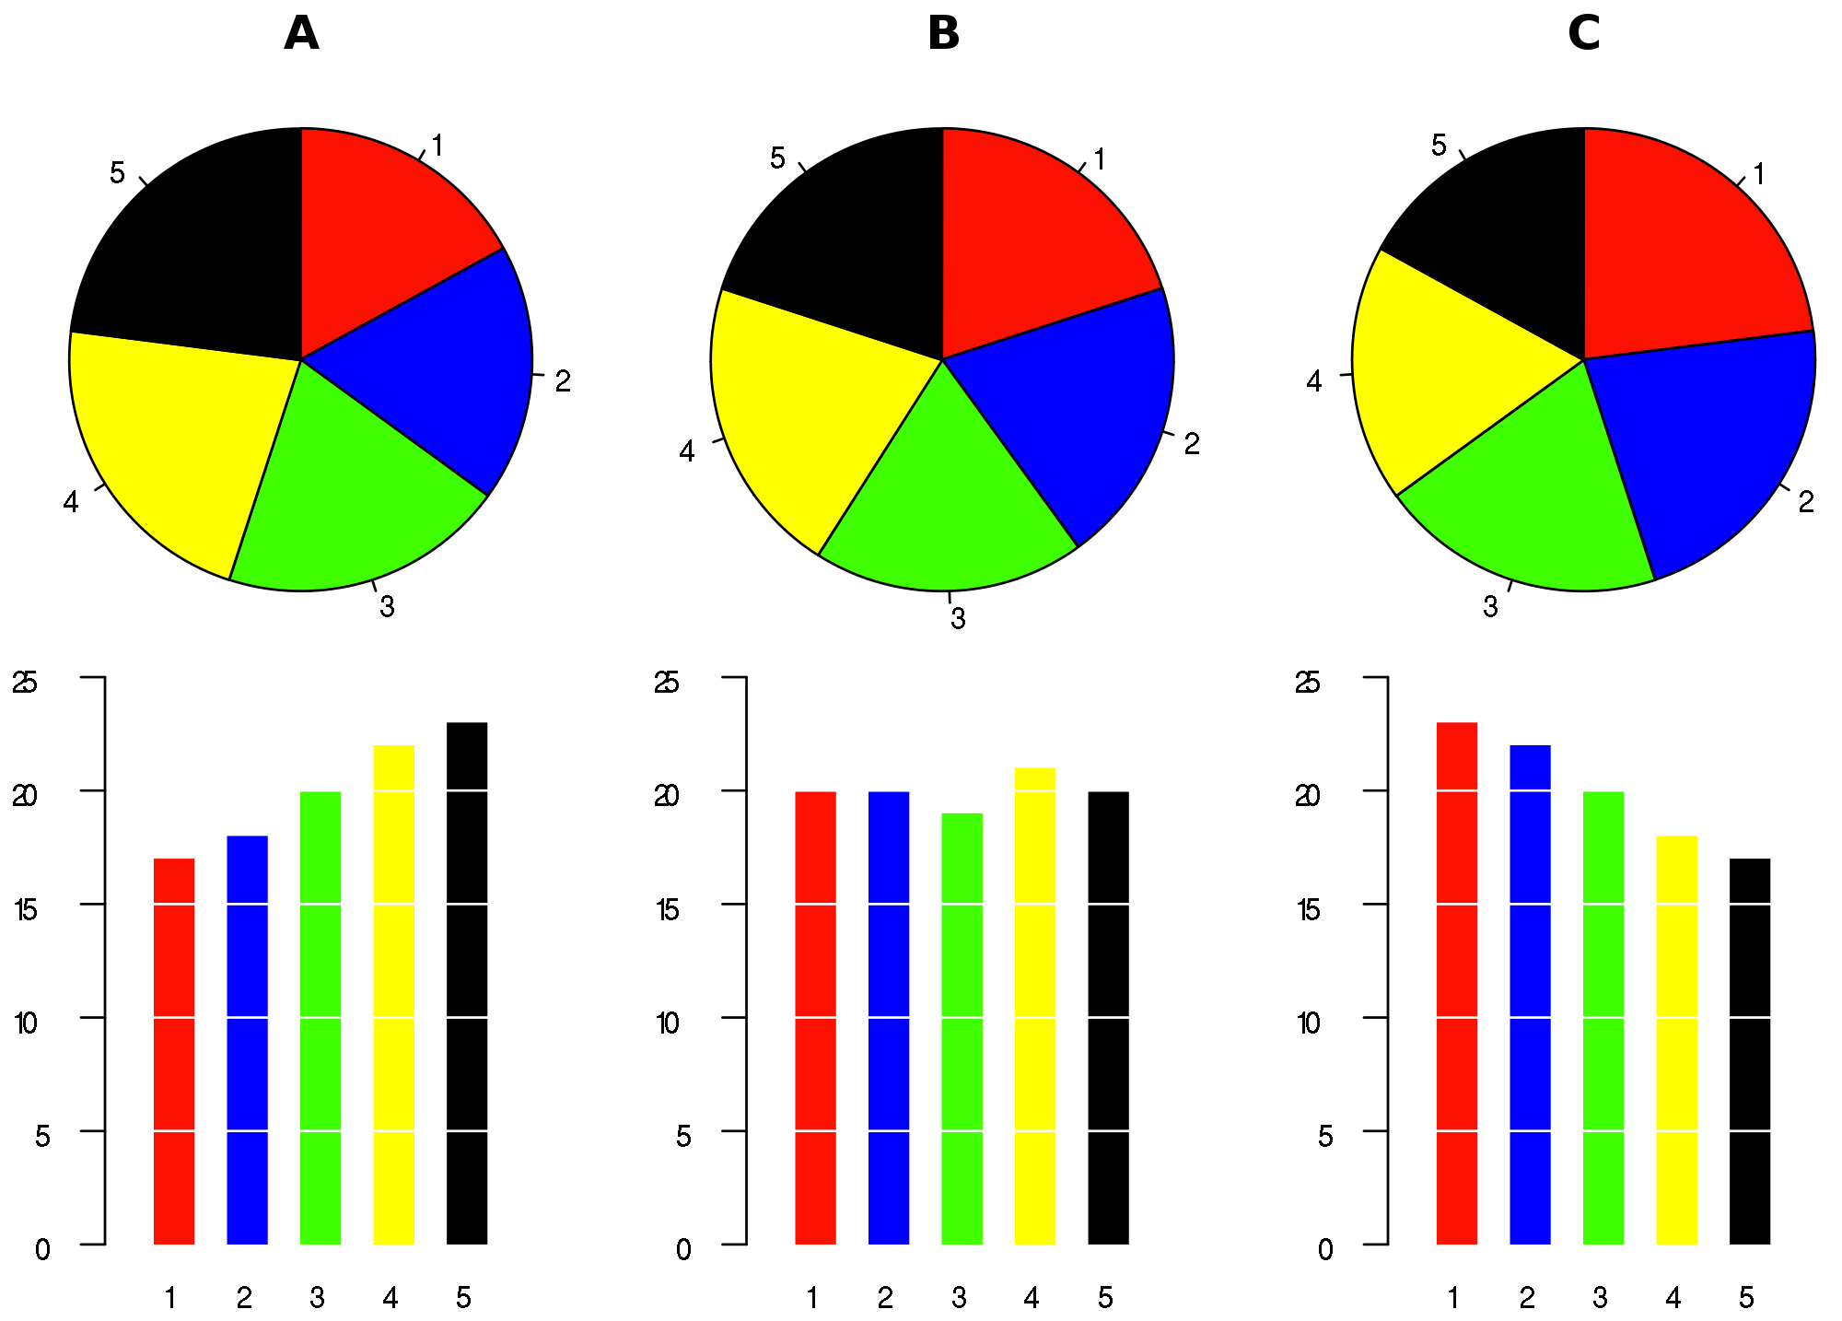
Data Visualisation
and Communication
> Always consider other ways to communicate the
story and evaluate your efforts

Slide 19
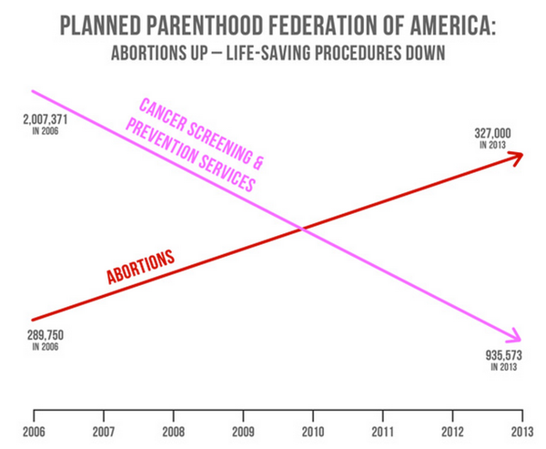
Data Visualisation
and Communication
NO!

Slide 20
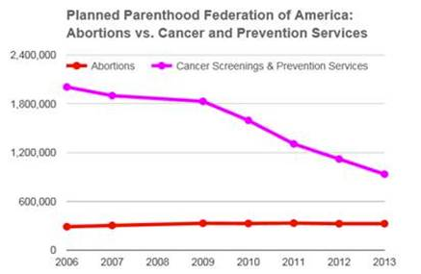
Data Visualisation
and Communication
BETTER!

Slide 21

Data Visualisation
and Communication
DEMO
Data Visualisation
We’re going to create a data visualisation dashboard that will help us understand Diabetes better on a local, national and international scale.
This demo uses Tableau, a data visualisation tool that is powerful and very intuitive. Feel free to follow along with the process or explore the code for yourself. Tableau Public is free and uni students can access more features by applying for a Tableau Desktop membership plan

Slide 22
End of Learning Lab, Part 2
Exploratory Data Analysis
Modelling
Data Visualisation & Communication
Next…. INNOVATION LAB

